Slide 1
Lesson Plan
Lesson Overview
Objective(s) | Simplify algebraic expressions by collecting like terms (adding and subtracting) |  |  |  |  | Grade | 4
Prior Knowledge | Number line Adding and subtracting positive and negative integers Concept of an algebraic term
Duration | Objective is limited to adding and subtracting. Content can be covered within 40 minutes.
Resources | Print slides: 23 - 25 |  |  | Equipment
Progression of Learning
What are the students learning? |  | How are the students learning? (Activities & Differentiation)
Sign at the front of the term applies to this term Can add or subtract if term is the same |  | PRINT slide 23. Demonstrate how to ”read” the expressions. That the sign at the front of the term applies to this term. Can be helpful to get students to circle the whole term including the sign. Particularly need to focus on negatives. Use slide 6 to explain each question for the demonstration. Then give students additional time to work on the practice sections. Solutions given on slide 8 and 10. |  |  |  |  | 15
Simplify algebraic expressions by collecting like terms in contextualised problems |  | PRINT slide 24. Explain to students that the algebraic expressions as not always given to them in a straight forward line. Instead they need to form the expressions. Normally this topic is combined with shape knowledge. Allow students to attempt question on their own for 2 minutes. Review question together and model answer. Allow the reasoning questions to be an opportunity to check for understanding. |  |  |  |  | 15
Simplify algebraic expressions by collecting like terms in exam questions (from specimen papers) |  | PRINT slide 25. This includes 9 exam questions related to objective. Students need to use notes from lesson to answer the questions. Ensure that all steps are shown. Relate to mark scheme to show how the marks are allocated. |  |  |  |  | 10
Next Steps | Further simplification (involving multiplying and dividing), index notation, expanding brackets | Assessment | PLC/Reformed Specification/Target 4/Algebra/Collecting like terms

Slide 2
Title: Collecting Like Terms
Aim:
Simplify algebraic expressions by collecting like terms (adding and subtracting).
Plan
Daily review
Skills practice
HUB?

Slide 3
Key vocabulary
Like terms
Simplify

Slide 4
Simplify by collecting like terms
1a
2a
3a
4a
1) a + a + a + a
2) b + c + b + c + b
3) 2m + 4p + 5m + 3p
4) 4x + 3y – 3x + 4y
= 4a (not a⁴)
1b
2b
3b
1c
2c
= 3b + 2c
2m
4p
7m
7p
= 7m + 7p
4x
1x
= x + 7y
3y
7y

Slide 5
Practice (1)
10a + 4a
2b + 7b
3a + a + 4a
11b – 4b
14b – 5b + 4b
3a – 6a + a

Slide 6
Practice (1) solutions
10a + 4a = 14a
2b + 7b = 9b
3a + a + 4a =8a
11b – 4b = 7b
14b – 5b + 4b = 13b
3a – 6a + a = -2a

Slide 7
Practice (2)
10a + 4b –a +5b
8a + 5a +5b – 3b
12b – 7a + 3b +a
2b – 8b –a + 9a
-13b + 4a -5b -4a
11a + 8b + 2c + 6a + 3b -2c
6b + 4b –a +6c + 5a – 4c
7c + 4b- 3b + a + 10c – 5a
10a + 4b + 7a + 10b – 17a – 14b
5b + 4c + 18c – 22a + z

Slide 8
Practice (2) solutions
10a + 4b –a +5b = 9a + 9b
8a + 5a +5b – 3b = 13a +2b
12b – 7a + 3b +a = -6a + 15b
2b – 8b –a + 9a = 8a -6b
-13b + 4a -5b -4a = -18b
11a + 8b + 2c + 6a + 3b -2c = 17a + 11b
6b + 4b –a +6c + 5a – 4c = 4a +10b +2c
7c + 4b- 3b + a + 10c – 5a = -4a + b +17c
10a + 4b + 7a + 10b – 17a – 14b = 0
5b + 4c + 18c – 22a + z = -22a + 5b +22c + z

Slide 9
Problem solving and reasoning
Here is an isosceles triangle
Find an expression for the perimeter of the triangle
5x - 2
22 – 4x

Slide 10
Problem solving and reasoning
Here is an isosceles triangle
Find an expression for the perimeter of the triangle
5x - 2
5x - 2
5x – 2 + 5x – 2 + 22 – 4x
= 10x – 4 + 22 - 4x
= 6x + 18
22 – 4x

Slide 11
Problem solving and reasoning
Rectangle
Triangle
14+ 20x
8x - 4
10 + 4x
5x + 15
2x
Show algebraically that the perimeters of these shapes are identical
10 x +30 + 16x – 8
= 26x + 24
10 + 4x + 14 + 22x
=26x + 24

Slide 12
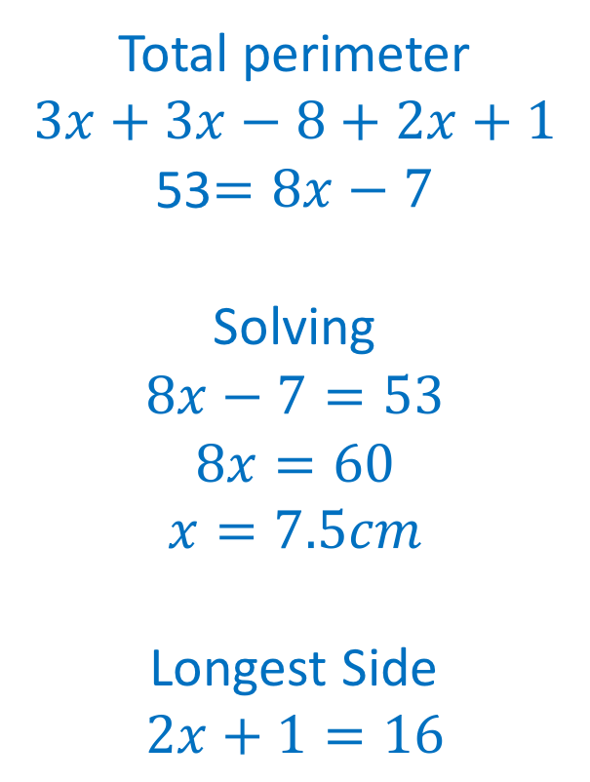
Problem solving and reasoning
The total perimeter of the shape below is 53 cm.
(a) Write an equation for the perimeter.
(b) Find the value of $x$ and hence the length of the longest side.
Total perimeter
$$3x+3x−8+2x+1$$
53$=8x−7$
Solving
$$8x−7=53 \\ 8x=60 \\ x=7.5cm$$
Longest Side
$$2x+1=16$$
$$3x − 8$$
$$3x$$
$$2x+1$$

Slide 13
Reasoning and explain
What is the difference between 4x and x⁴ ?
Can you write an expression that will simply to 6x – 4y? Are there any more?
What do you look for when you simplify an expression? What is important?
Spot the mistake: 3x + y – x + 2y = 3 + 3y
4x = x + x + x + x
x⁴ = x x x x x x x
2x + 10y + 4x – 14y
LOTS!
The same terms
Check for signs (+/-)
Should be 2x NOT 3

Slide 14
Simplify by collecting like terms
DEMO
PRACTICE
PRACTICE 2
1) a + a + a + a
2) b + c + b + c + b
3) 2m + 4p + 5m + 3p
4) 4x + 3y – 3x + 4y
10a + 4a
2b + 7b
3a + a + 4a
11b – 4b
14b – 5b + 4b
3a – 6a + a
10a + 4b –a +5b
8a + 5a +5b – 3b
12b – 7a + 3b +a
2b – 8b –a + 9a
-13b + 4a -5b -4a
11a + 8b + 2c + 6a + 3b -2c
6b + 4b –a +6c + 5a – 4c
7c + 4b- 3b + a + 10c – 5a
10a + 4b + 7a + 10b – 17a – 14b
5b + 4c + 18c – 22a + z
Student Sheet 1

Slide 15
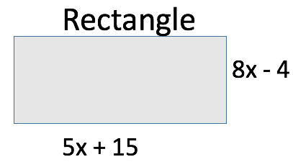
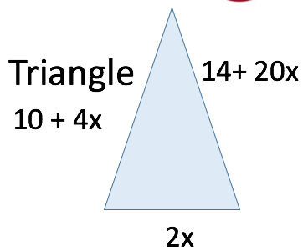
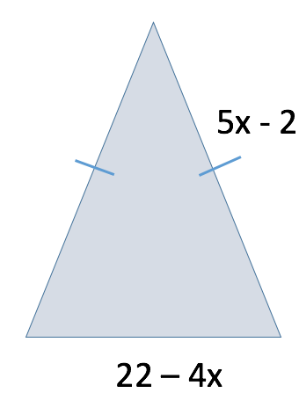
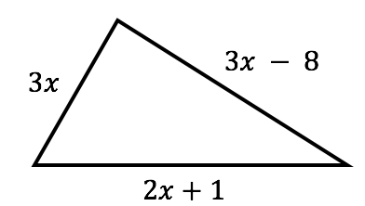
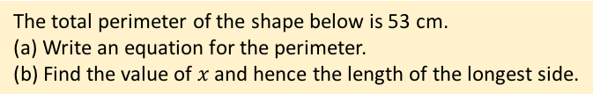
Problem solving and reasoning
Here is an isosceles triangle. Find an expression for the perimeter of the triangle
Show algebraically that the perimeters of these shapes are identical
The total perimeter of the shape below is 53 cm.
(a) Write an equation for the perimeter.
(b) Find the value of $x$ and hence the length of the longest side.
What is the difference between 4x and x⁴ ?
Can you write an expression that will simply to 6x – 4y?
What do you look for when you simplify an expression?
Spot the mistake: 3x + y – x + 2y = 3 + 3y
Student Sheet 2

Slide 16
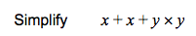
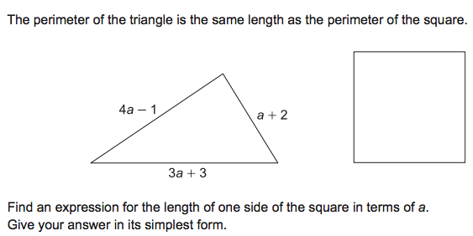
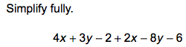

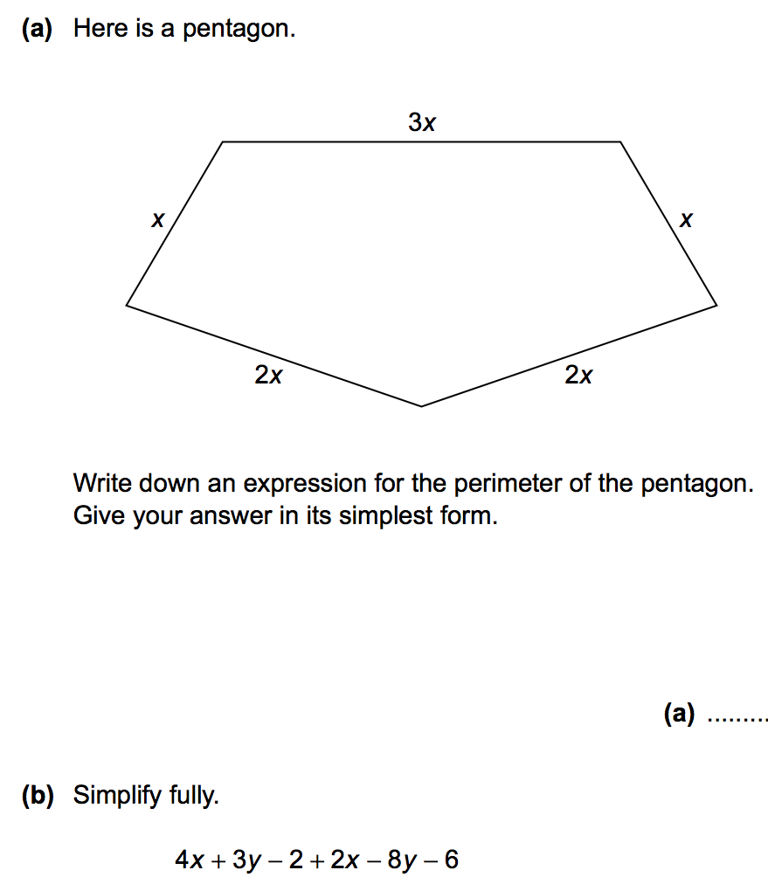
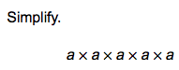
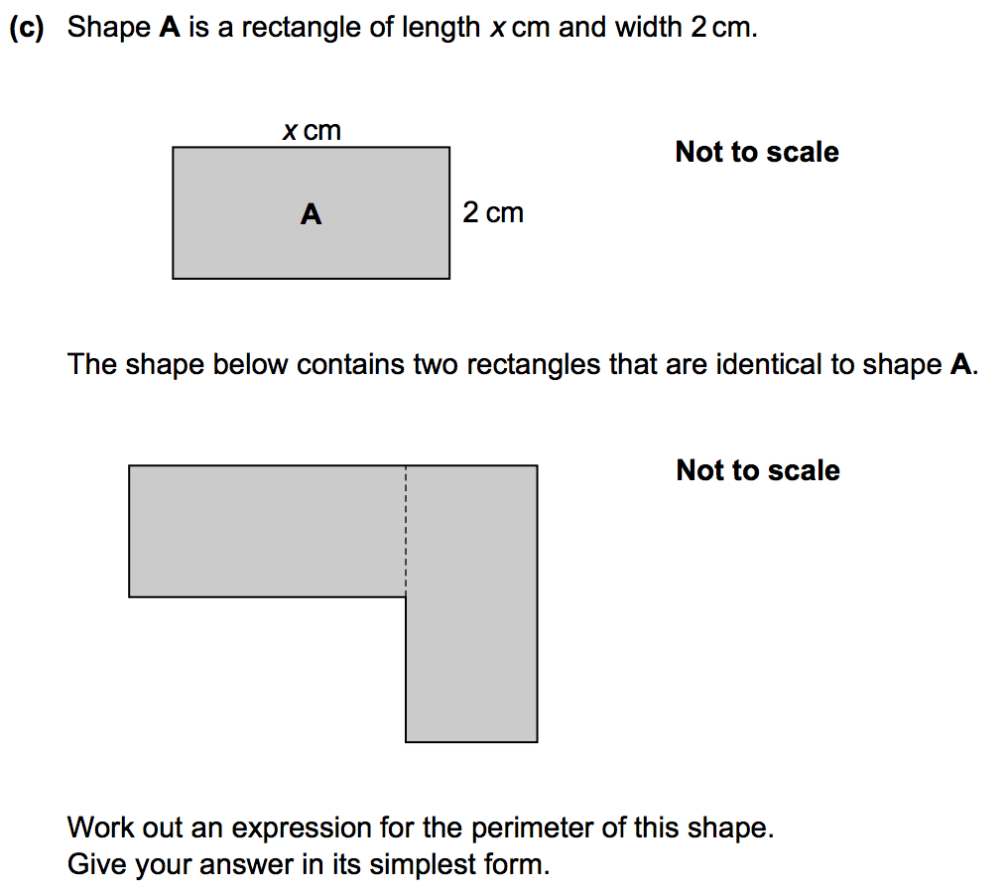
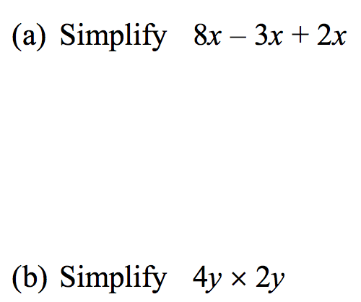
Exam specimen questions
[1 mark]
[2 marks]
[2 marks]
[2 marks]
[4 marks]
[2 marks]
[1 mark]
[1 mark]
[2 marks]
Student Sheet 3
[2 marks]
[3 marks]

